Slide 1
Lesson objective
Title: Splitting quantities
Aim:
Use division to determine values from a given ratio
Plan:
Simplify ratios
Dividing parts

Slide 2
Simplifying ratios
I do
4 : 8
10 : 15
21 : 3
3cm : 50mm
We do
12 : 6
18 : 24
120 : 30
12hrs : 1 day
You do
6 : 24
25 : 15
20 : 50
30c : $3

Slide 3
How much rent?
You and 2 mates are paying different amounts in rent. You get the master bedroom, so you pay a little more, Joe pays a little less.
You : Joe : Sam
: 2 : 3
If the rent is $450 per week, how much do you each pay?

Slide 4
Dividing by a ratio
Learning Objectives
To be able to simplify ratios
To be able to divide an amount by a given ratio
Steps to Success
Add together the total number of parts of the ratio
Divide the given amount by the total number of parts
Multiply the answer by each ratio amount
Check that your answers add up to the same total given in the question

Slide 5
I do
Add together the total number of parts of the ratio
Divide the given amount by the total number of parts
Multiply the answer by each ratio amount
Check that your answers add up to the same total given in the question
Share 100 in the ratio of 4 : 6
Share 36 in the ratio of 4 : 5
Share 44 in the ratio 9 : 2

Slide 6
We do
Add together the total number of parts of the ratio
Divide the given amount by the total number of parts
Multiply the answer by each ratio amount
Check that your answers add up to the same total given in the question
Share 99 in the ratio of 5 : 6
Share 21 in the ratio of 1 : 2
Share 24 in the ratio 4 : 3 : 1

Slide 7
Whiteboards
Share 20 into the ratio 2 : 8
Share 40 into the ratio 5 : 3
Share 25 into the ratio 2 : 3

Slide 8
How much rent?
You and 2 mates are paying different amounts in rent. You get the master bedroom, so you pay a little more, Joe pays a little less.
You : Joe : Sam
: 2 : 3
If the rent is $450 per week, how much do you each pay?

Slide 9
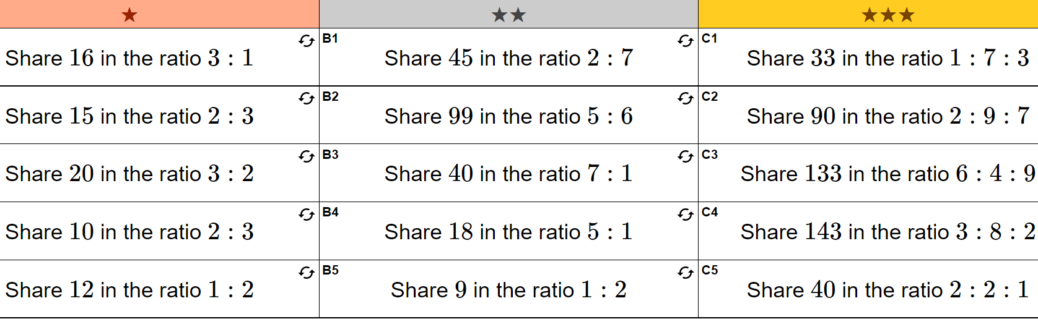
You do – exercise books

Slide 10
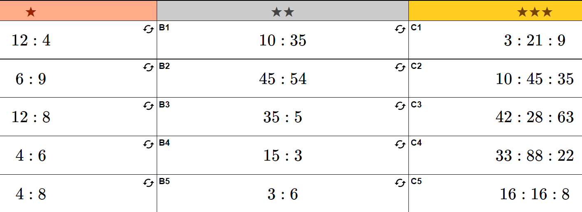

Slide 11



How did you do?
All or almost all answers correct
Most answers correct, some errors
Majority of answers incorrect

Slide 12
Individual practice
Complete “Ratio worksheet”

